Slide 1

Student Id: 7214
SQL Project Presentation
By Sachin Sah
From Ivy Professional School

Slide 2
Project Introduction
Objective:
Analyze customer behavior and product performance using SQL.
Providing insights on the results and figuring out solutions of the business problems.
Data Sources:
Customers, Orders, Products, and Reviews tables.
This is based on an AI generated Dataset.

Slide 3
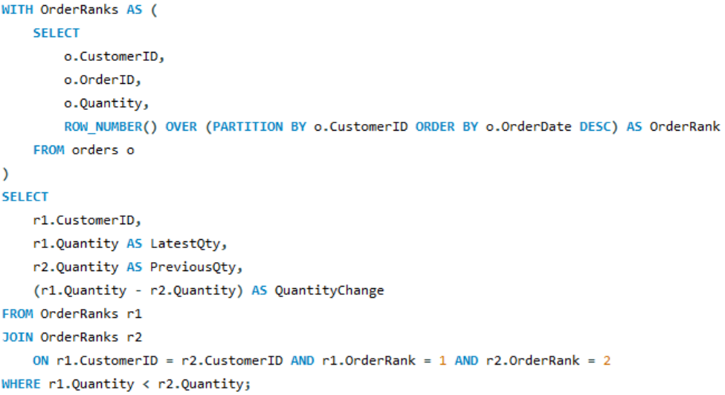
Sample Questions & Solutions
1. Customers With Decreasing Purchase Trend
Insights:
Some customers have reduced their order quantity in their latest purchase compared to the previous one.
This may signal waning interest or potential dissatisfaction.

Slide 4
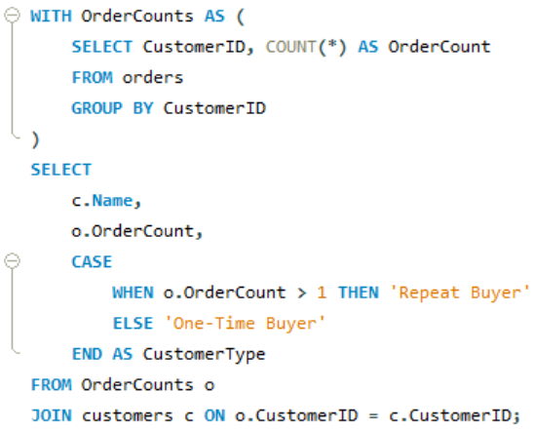
2. Repeat Customers vs. One-Time Buyers
Insights
A large share of customers are one-time buyers, highlighting a gap in customer retention.
Repeat purchases are low, likely due to limited perceived value or lack of post-sale engagement.

Slide 5
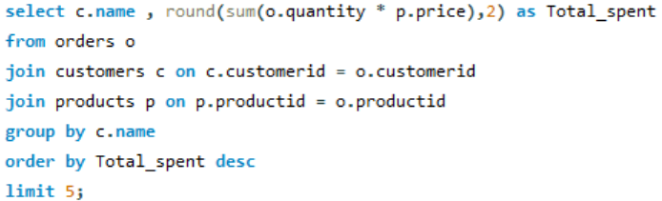
3. Find top 5 customers who spent the most.
Insights :
Top customers like Sana Sarin and Gatik Walla contribute significantly to total revenue, indicating a small group of high-value buyers.

Slide 6
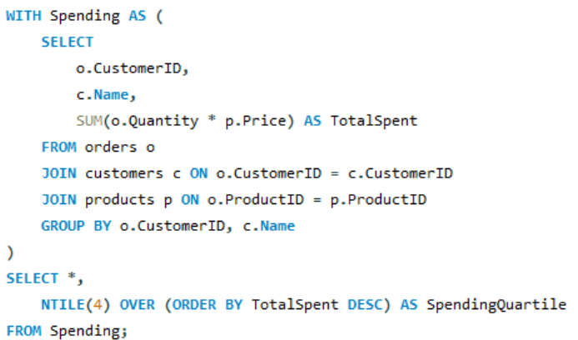
4. Customer Spending Quartiles.
Quartile | Description | Strategy
1 | Top 25% spenders (VIPs) | Loyalty programs, early access
2 & 3 | Mid-value customers | Upsell, standard campaigns
4 | Low spenders (bottom 25%) | Discounts, re-engagement offers

Slide 7
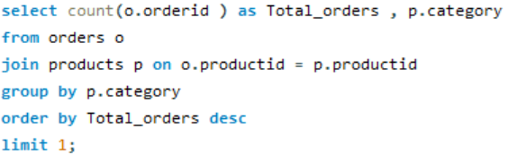
5. Find the most ordered product category.
Insights:
The Cleaning category is the most ordered, with 54 total orders.
This highlights strong customer demand and interest in hygiene-related products.

Slide 8
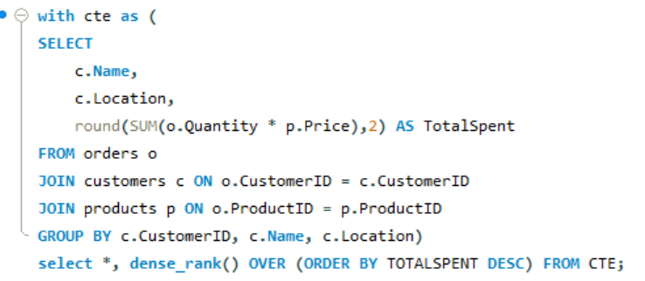
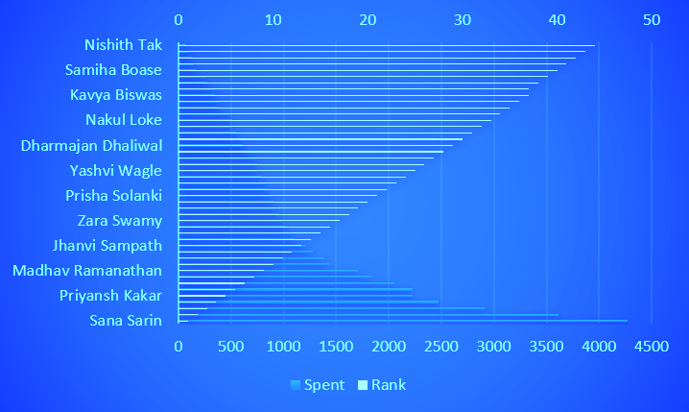

6. Show each customer's total spending and their rank based on spending within their city.
Insights:
A small group of high-value customers drives most of the sales, while many others spend significantly less.

Slide 9
Recommendations
Re-engage one-time buyers with personalized offers.
Gather feedback to understand why customers don’t return.
Monitor them as at-risk for churn and follow up with retention strategies.
Launch loyalty programs and personalized campaigns to retain and engage these top spenders.
Focus on the cleaning category by expanding product options & Bundling with complementary items to boost overall sales.
Encourage mid-tier customers with reward-based promotions.
Re-engage low spenders using discounts and feedback.
Use city-level campaigns to tap underperforming regions.

Slide 10
Conclusion
This project demonstrates how SQL can transform raw data into actionable insights, helping businesses:
Optimize operations
Understand customer behavior
Drive better product and marketing decisions

